Slide 1
Welcome!
Sunday
Bible Study 9:30 AM
Worship 10:30 AM
PM Bible Class (Livestream) 5:00 PM
Wednesday
Bible Class 7:00 PM
www.SunsetchurchofChrist.net

Slide 2
John 8:21-30
Jesus reveals His goal
Belief in Jesus
Speaking from the Father

Slide 3
Welcome!
Sunday
Bible Study 9:30 AM
Worship 10:30 AM
PM Bible Class (Livestream) 5:00 PM
Wednesday
Bible Class 7:00 PM
www.SunsetchurchofChrist.net

Slide 4
Opening Prayer
Song – | George Watkins
Scripture Reading
Song – | George Watkins
Song – | George Watkins
Lord’s Supper
Song – | George Watkins
Collection
Song – | George Watkins
Lesson | Brian Haines
Song – | George Watkins
Closing

Slide 5
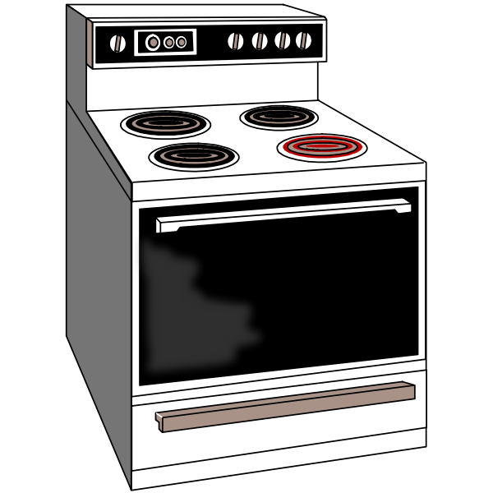
Mind of Maturity
Notes:
We teach a infant not to touch the hot surface by swatting their hand
We teach a child or adolescent that they will get burned
We learn as an adult that anything hot can hurt

Slide 6
Maturity and Attitude
Therefore let us, as many as are mature, have this mind; and if in anything you think otherwise, God will reveal even this to you. Philippians 3:15

Slide 7
Maturity and Attitude
We can discern our maturity by attitude
What motivates our behavior
Maturity has different motivations

Slide 8
Maturity and Attitude
1. Its about me;
I don’t want to suffer or be punished
2. Its about God;
I want to please Him
3. It is about God’s people;
That is where I can find God

Slide 9
Maturity and Purpose
1. I do not want to go to hell
Mark 9:43-44
2. I want to go to heaven
Ephesians 1:18
3 I want to please God
2 Corinthians 5:14
Notes:
Mr 9:43 "If your hand causes you to sin, cut it off. It is better for you to enter into life maimed, rather than having two hands, to go to hell, into the fire that shall never be quenched 44 "where 'Their worm does not die, And the fire is not quenched.‘
Eph 1:18 the eyes of your understanding being enlightened; that you may know what is the hope of His calling, what are the riches of the glory of His inheritance in the saints,
2Co 5:14 For the love of Christ compels us, because we judge thus: that if One died for all, then all died;

Slide 10
Maturity and Sin
1. Sinning condemns me
John 5:14
2. Causing someone else to sin is bad
Matthew 18:7
3. What does God want me to do?
Ephesians 5:10
Notes:
Joh 5:14 Afterward Jesus found him in the temple, and said to him, "See, you have been made well. Sin no more, lest a worse thing come upon you.“
Mt 18:7 ¶ "Woe to the world because of offenses! For offenses must come, but woe to that man by whom the offense comes!
Eph 5:10 finding out what is acceptable to the Lord.

Slide 11
Maturity and Assembly
1. I go to church to take the Lord’s Supper
Acts 20:7
2. I go to worship God
John 9:31
3. I go to encourage other Christians
Hebrews 10:24-25
Notes:
Heb 10:24 And let us consider one another in order to stir up love and good works, 25 not forsaking the assembling of ourselves together, as is the manner of some, but exhorting one another, and so much the more as you see the Day approaching.

Slide 12
Maturity and Choices
1. My choices have consequences
Romans 6:23
2. My choices have unforeseen consequences
1 Corinthians 7:16
3. My choices have consequences for others
1 Corinthians 8:12-13
Notes:
1Co 7:16 For how do you know, O wife, whether you will save your husband? Or how do you know, O husband, whether you will save your wife?
1Co 8:12 But when you thus sin against the brethren, and wound their weak conscience, you sin against Christ 13 Therefore, if food makes my brother stumble, I will never again eat meat, lest I make my brother stumble.

Slide 13
Maturity and Understanding
1. I study the Bible because I am told to
2 Timothy 2:15
2. I study the Bible because I want to
1 Peter 2:2
3. I study the Bible because I need to
Acts 5:20
Notes:
1Pe 2:2 as newborn babes, desire the pure milk of the word, that you may grow thereby,
Ac 5:20 "Go, stand in the temple and speak to the people all the words of this life."

Slide 14
Maturity and Self-Examination
We need to labor to expand our spirituality
We need to accept that there is more to grow
We need to better ourselves in serving God

Slide 16
How Do We Obtain Eternal Life
Hearing and Believing
Confessing
Repenting
Being Baptized
Remaining Faithful
Notes:
Ac 15:11 "But we believe that we are saved through the grace of the Lord Jesus, in the same way as they also are."

